Slide 1


Artificial Intelligence Internship
IILM UNIVERSITY, GREATER NOIDA
Customer Churn Prediction & Advanced Movie Recommendation System at Codec Technologies
VAISHNAVI SHARMA
Roll No.: 2410030681
B.Tech CSE — 5th Semester, 3CSE21 Organization: Codec Technologies Pvt. Ltd.

Slide 2







Agenda
O V E R V I E W
Organization Profile
Who Codec Technologies is and what it does
Internship Overview
Role, duration, and working mode
Problem & Objectives
What needed to be solved, and why
Technology & Architecture
Stack, tools, and system design
Methodology & Delivery
How the project was built
Outcomes & Learnings
Results and takeaways

Slide 3

Codec Technologies
IT & Business Consultancy — AICTE & ICAC Approved Training Partner
O R G A N I Z A T I O N P R O F I L E
An IT and business consultancy and skilling platform delivering services across 27+ countries, offering AICTE- and ICAC-approved internship programs listed on the National Internship Portal.
Global & Accredited
Program Manager:
Dr. Anurag Shrivastava
Headquarters:
Chandivali IT Hub, Mumbai
Google for Education partner, MSME accredited, and a certified internship provider recognized by central and state universities — giving academic validity to
project-based internship work.
Certifications:
ISO 9001:2015, AICTE, ICAC
Scale:
17,500+ interns trained

Slide 4




Role, Duration & Mode
I N T E R N S H I P O V E R V I E W
Position
Duration
Mode
Reporting
Artificial Intelligence Intern
1 Month
(17 AUG-17 SEP 2026)
Pan India, Hybrid
Assigned Project Head(s)
Certificate of Internship
Issued by Codec Technologies Pvt. Ltd. on completion of the 1-Month AICTE & ICAC-approved internship program as Artificial Intelligence Intern (AICTE ID: CORPORATE6759d549ce59e1733940553).

Slide 5
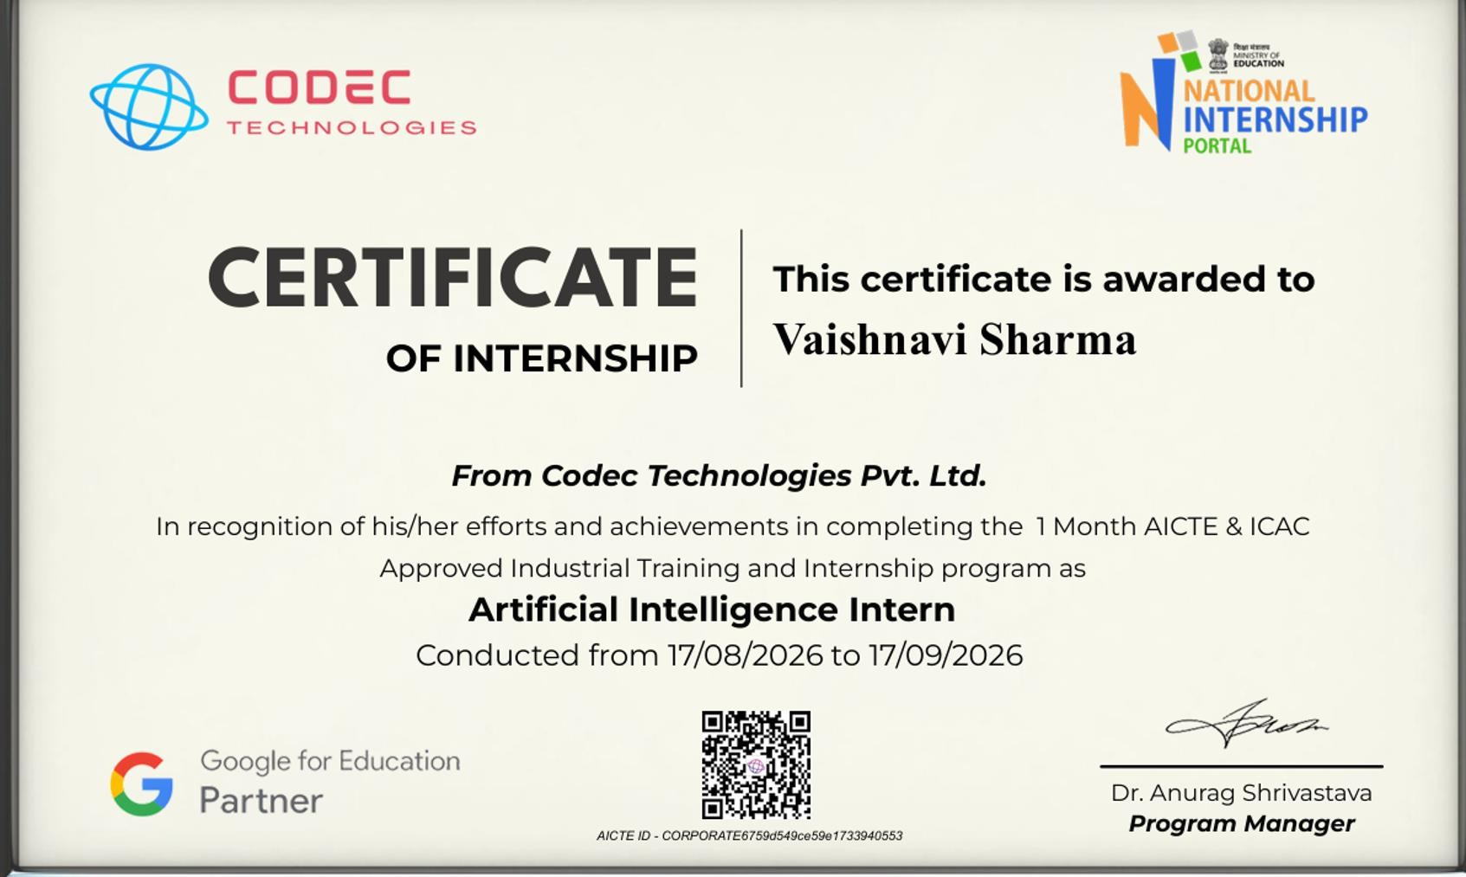

Slide 6


Problem Statement
T H E C H A L L E N G E
Unpredictable Customer Churn
Subscription businesses lose recurring revenue when customers leave without warning. Without a predictive system, retention teams can only react after a customer has already gone.
Generic, Unpersonalized Recommendations
Basic approaches like “show the most popular titles to everyone” fail to personalize content, leading to lower engagement. A smarter
approach needs both a user's own preferences and patterns from similar users.
5 / 15

Slide 7
Project Objectives
G O A L S
1
Build a churn prediction model classifying customers as likely to churn or be retained
2
Engineer meaningful features (tenure, engagement, plan, support history) for churn signal
3
Design a hybrid movie recommender combining content-based & collaborative filtering
4
Evaluate both models with standard metrics and interpret results in business terms
5
Document the full pipeline end-to-end, from raw data to final model, reproducibly
6 / 18

Slide 8
Scope of the Project
B O U N D A R I E S
In Scope
Out of Scope
Data collection, cleaning & exploratory analysis
✗ Live production deployment of either model
Feature engineering for churn prediction
✗ Integration with a real company's live database
Churn classification model build & evaluation
✗ Live A/B testing of recommendations or retention offers
Hybrid movie recommender build & evaluation

Slide 9






Technologies & Tools
U N D E R T H E H O O D
Python
NumPy & Pandas
Matplotlib & Seaborn
Primary language across the entire pipeline
Data cleaning, transformation & feature engineering
Exploratory data analysis and result visualization
Scikit-learn
Recommendation Engine
Jupyter & Git
Churn classification: Logistic Regression, Random Forest, XGBoost
Cosine similarity, content-based & collaborative filtering
Iterative model development with version control

Slide 10
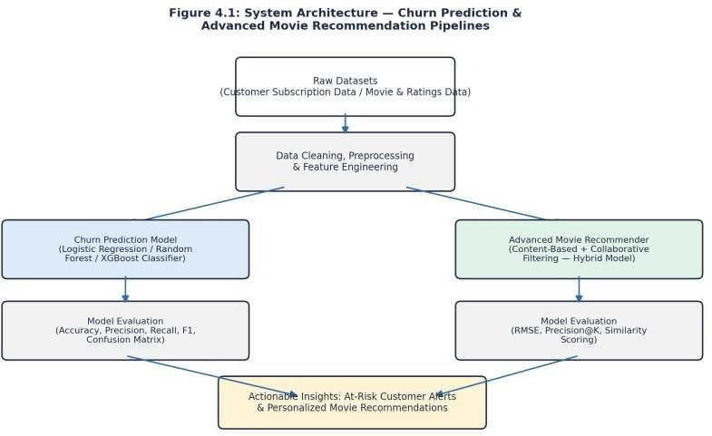
System Architecture
D E S I G N
A shared data pipeline branches into two independent modelling tracks that both feed into actionable business insights.

Slide 11
Development Methodology
H O W I T W A S B U I L T
01
Explore
02
Engineer
03
Model
04
Evaluate
→
→
→
Clean the data and explore class balance, distributions & rating patterns
Build predictive features for churn; vectorize content features for recs
Train classifiers for churn; build hybrid content + collaborative recommender
Accuracy/F1/confusion matrix for churn; RMSE/precision@K for recommender
Progress was tracked through weekly performance reviews conducted by the assigned project supervisor.

Slide 12



Customer Churn Prediction Model
K E Y D E L I V E R A B L E 0 1
A classification model that flags customers likely to churn, giving retention teams a usable signal to act on before it's too late.
Feature Engineering
Classifier Models
Evaluated Rigorously
Tenure, engagement, subscription plan & support history encoded as model features
Logistic Regression, Random Forest, and XGBoost trained and compared
Accuracy, precision, recall, F1 & confusion matrix used to weigh trade-offs

Slide 13

Advanced Movie Recommendation System
K E Y D E L I V E R A B L E 0 2
A hybrid recommender combining content-based and collaborative filtering for more personalized movie suggestions.
Content-Based Filtering
Collaborative Filtering
Movie metadata (genre and other attributes) vectorized and compared using cosine similarity — recommending “movies like the ones you rated highly.”
A user-item ratings matrix captures patterns across similar users, blended with the content signal into one hybrid score — evaluated with RMSE and precision@K.

Slide 14

Outcomes & Results
I M P A C T
Churn model distinguished at-risk from retained customers with meaningfully better-than-baseline performance
Confusion matrix & precision/recall trade-offs framed the real retention cost of misses vs. false alarms
Hybrid recommender produced more personalized results than a single-signal baseline
Both pipelines documented reproducibly — ready to re-run on updated data or extend further

Slide 15
Offer Letter & Completion Certificate
V E R I F I C A T I O N

Slide 16






CODEC
NATIONAL
INTERNSHIP
INTERNSHIP OFFER LETTER
oeor voishnovi shormo,
\^/e ore pleased to offer you a I Month Internship as Project Infern at codec Technologies, a global platform dedlcoted to empowering learners and connecting diverse talent to create meaningful career opportunities worldwide. codec Technologies delivers dedlcofed iT and business consultancy servlces across 27* countries, empowering global Innovation and strategic growth.
Internship retails:
Designation : Ar1 ficiol InteIIIger\ce lnfern
Loco\ion6 Mode: Pan India, Hybrid
Duratlon : \?/OB/2026 to \7/09/202B
Reportlng to: Asslgned Project Head(s)
This program provides on immerslve experience, enobllng you fa gain iAustry-level knowledge and acquire valuable skills. Exceptlonol Interns may also quollfy for a scholarship award based on weeLly performance revlews conduMed by project supervisor.
If you accept this offer and the rerms above, please complete your osslgned projects and training tosLs on our platform and vlo email.
Best
sincerely,
a . Anurog shrivostovo,
codec Technologies India NCS TD: Et8E8B-0t16588288823
oote of Issue — t7/08/2028
Dr.Auu*xgshrnmetsva
Goog1e for Eduration
Partner
urur+voode<ñaoImoIc•giea in
e ppsrt@codectenhnoki@s.In
Chendi¥eli IT hub. Plumbed

Slide 17





This certificate is awarded to
Vaishnavi Sharma
_{a,}h-
INTERNSHIP
CERTIFICATE
OF fHTERHSH›P
From Codec 7echno/ogies Pvt. Ltd.
In recognition of his/her efforts and achievements in completing the 1 Month AICTE & ICAC Approved Industrial Training and Internsh ip program as
Artificial Intelligence Intern
Conducted from 17/08/2026 to 17/09/2026
O•
'¥„ Partner
Dr. Anurag Shrivastava
Program Manager
AIC TE ID - CORPORA 7E6759cfñfd9cuJ9e 7 73394g553

Slide 18

Thank You
Questions & Discussion
VAISHNAVI SHARMA
B.Tech CSE, IILM University, Greater Noida Artificial Intelligence Intern, Codec Technologies
Summer Internship Presentation
15 / 15

